Slide 1
Business Process Integration with SAP ERP
Chapter 9
Process Integration

Slide 2
Background
Thus far the book has covered the following key processes:
    Financial accounting
    Procurement
    Fulfillment
    Production
    Inventory and warehouse management
    Material planning
Each of these processes has triggers, data, tasks, and outcomes

Slide 3
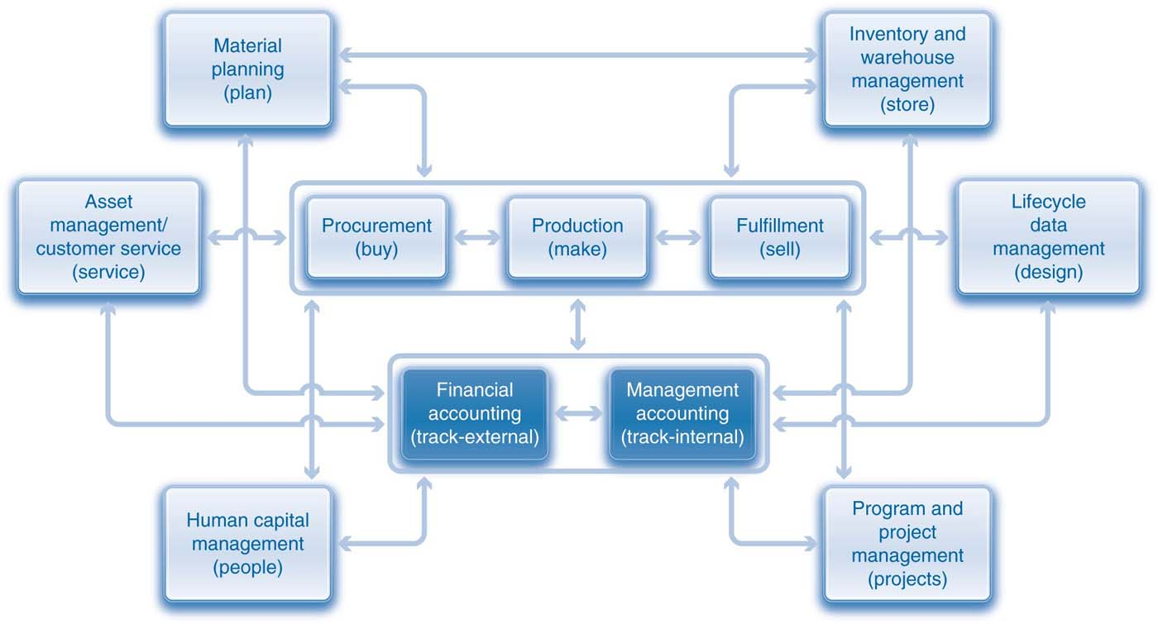
Integrated Business Processes

Slide 4
Background
Production strategies
    Make-to-stock
    Make-to-order
Procurement strategy
    Procure-to-stock
    Procure-to-order
Fulfillment strategy
    Sell-from-stock

Slide 5
Background
Make-to-stock, procure-to-stock, and sell-from-stock strategies use inventory as a buffer between processes to de-couple them or make them less dependent on one another.
To illustrate integration among processes, the scenarios will no longer assume that there is a sufficient inventory of raw materials for production or of finished goods for fulfillment.
The discussion will focus on the make-to-order and procure-to-order strategies.

Slide 6
Background
Two scenarios are presented
    Scenario one - Filling a customer order for trading goods
      Procurement, fulfillment, IWM
    Scenario two – Filling a customer order for finished goods
      Procurement, fulfillment, production, IWM

Slide 7
Procurement, Fulfillment, Production, and IWM Processes
Rocky Mountain Bikes (RMB) has ordered 40 Red Deluxe Touring Bikes (DXTR3000) from GBI.
Assumptions
    The Dallas plant currently does not have any touring bikes in inventory.
      When it does have these bikes, the standard price is also $1,400.
    The Dallas plant has 200 aluminum wheel assemblies that are needed to produce touring bikes.
      The standard price for these wheel assemblies is $110.
    RMB has sent GBI a purchase order for 40 Red Deluxe Touring Bikes.
    GBI sells these bikes for $2,800 each.
    Bikes are produced in Dallas and shipped to San Diego via STO

Slide 8
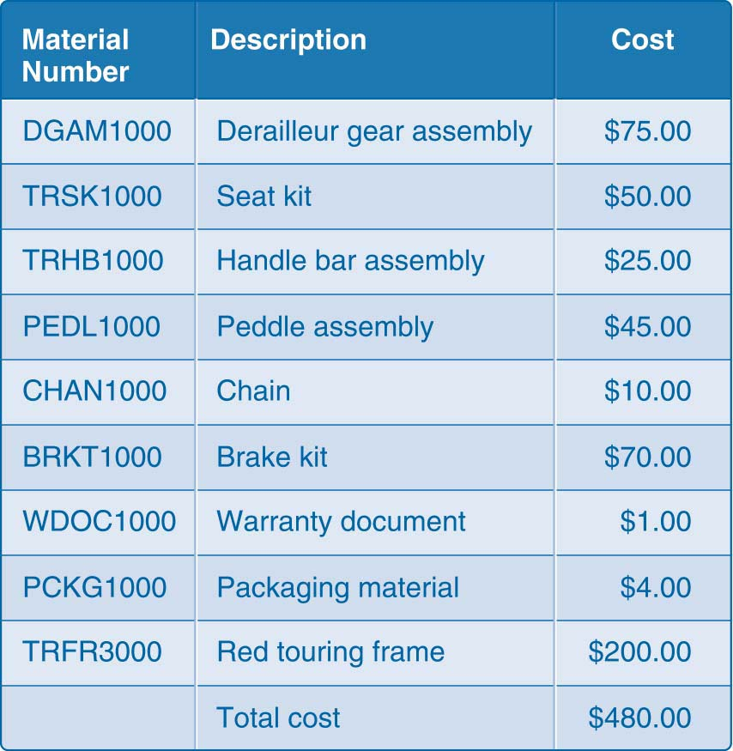
Raw Material Cost per Bike

Slide 9
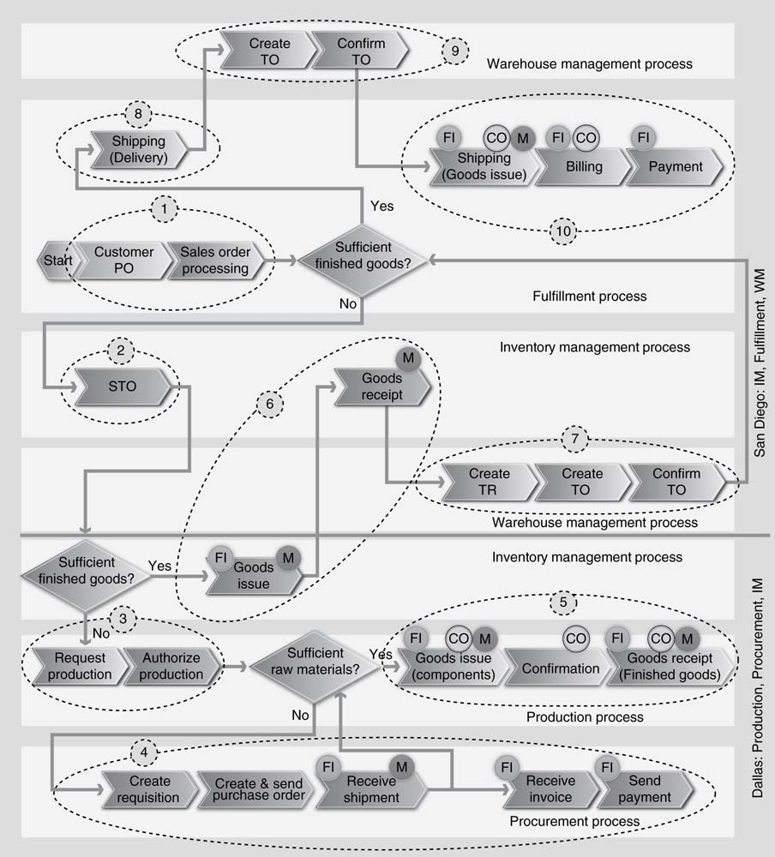
Procurement, Fulfillment, Production, and Warehouse Management Processes

Slide 10
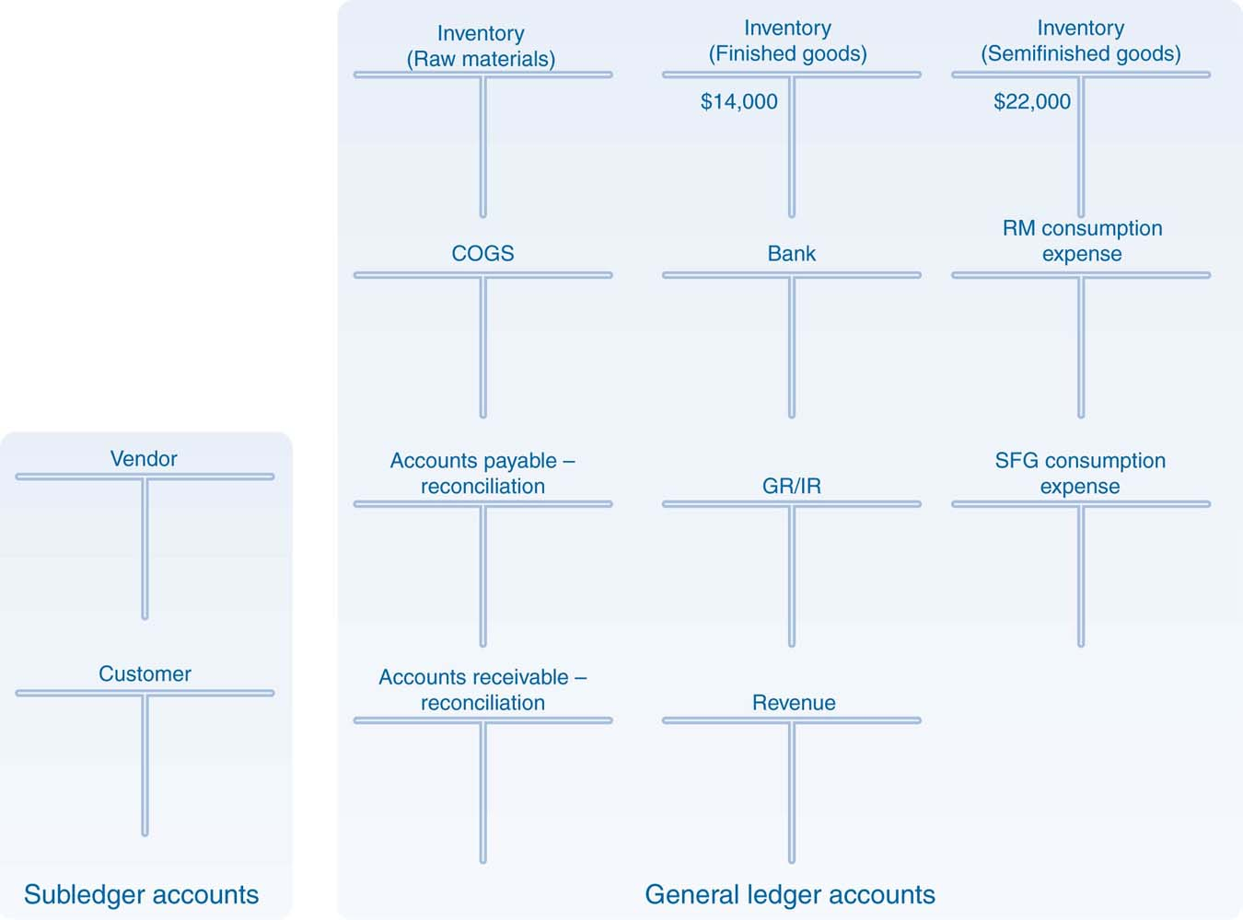
Account Balances – Start of Process
Demo: Review Financials / SRL / MAP

Slide 11
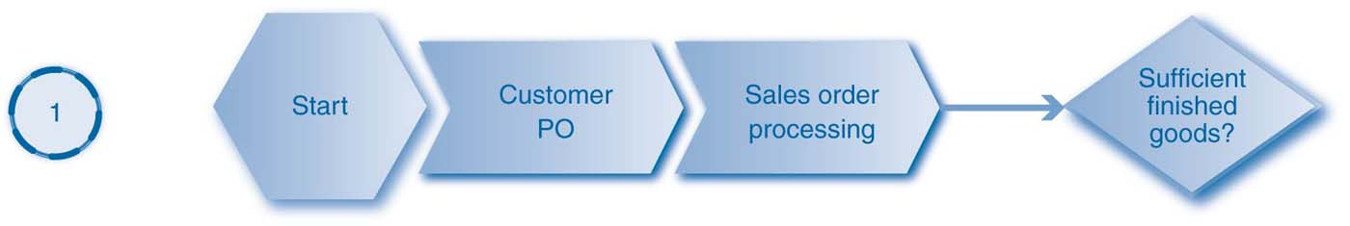
Fulfillment Process – Initial Steps
This following scenario for the fulfillment process is very similar to the one that was previously discussed.
RMB’s purchase order triggers the integrated process and prompts GBI to create a sales order.
The ERP system performs an availability check.
Demo: Create Sales Order

Slide 12

Inventory Management – Initial Step
Demo: Create STO

Slide 13
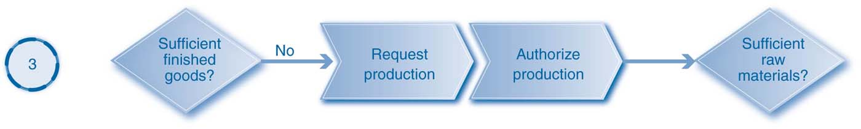
Production Process – Initial Steps
Demo: MRP; Prd Ord

Slide 14
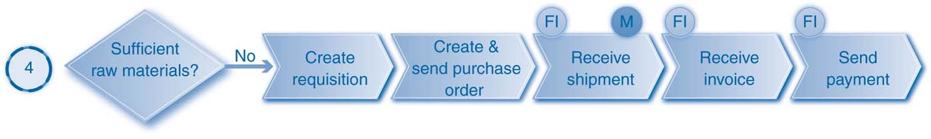
Procurement Process (External)
Demo: Execute Procurement

Slide 15
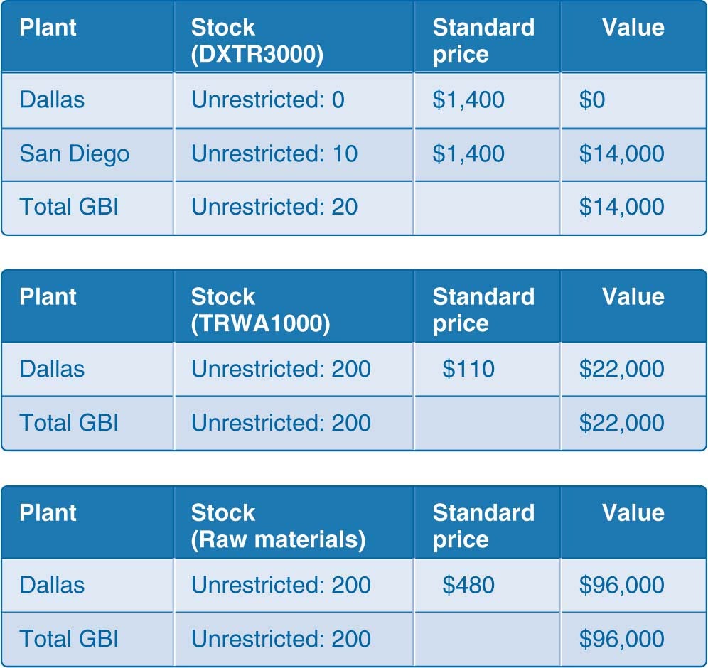
Plant Stock Valuation after External Procurement
Demo: Review MAP

Slide 16
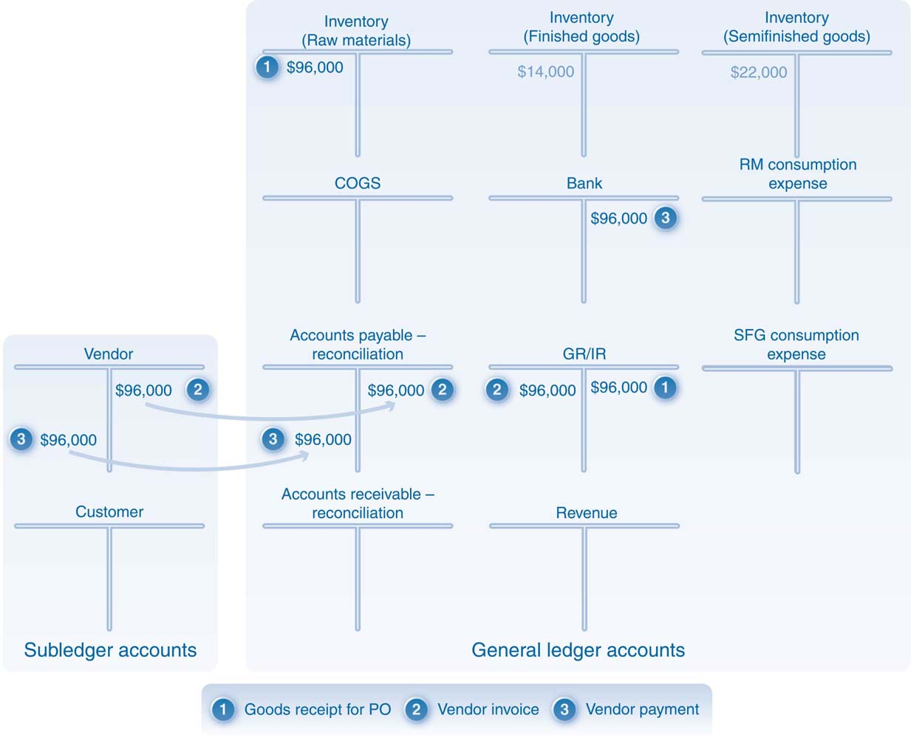
Account Balances after External Procurement
Demo: Review Financials

Slide 17
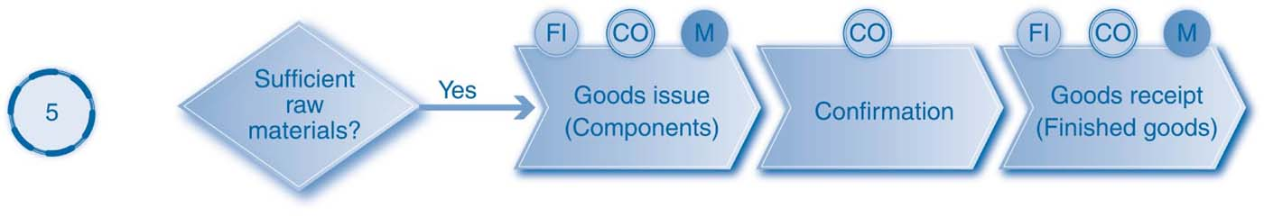
Production Process - Continued
Demo: Complete production

Slide 18
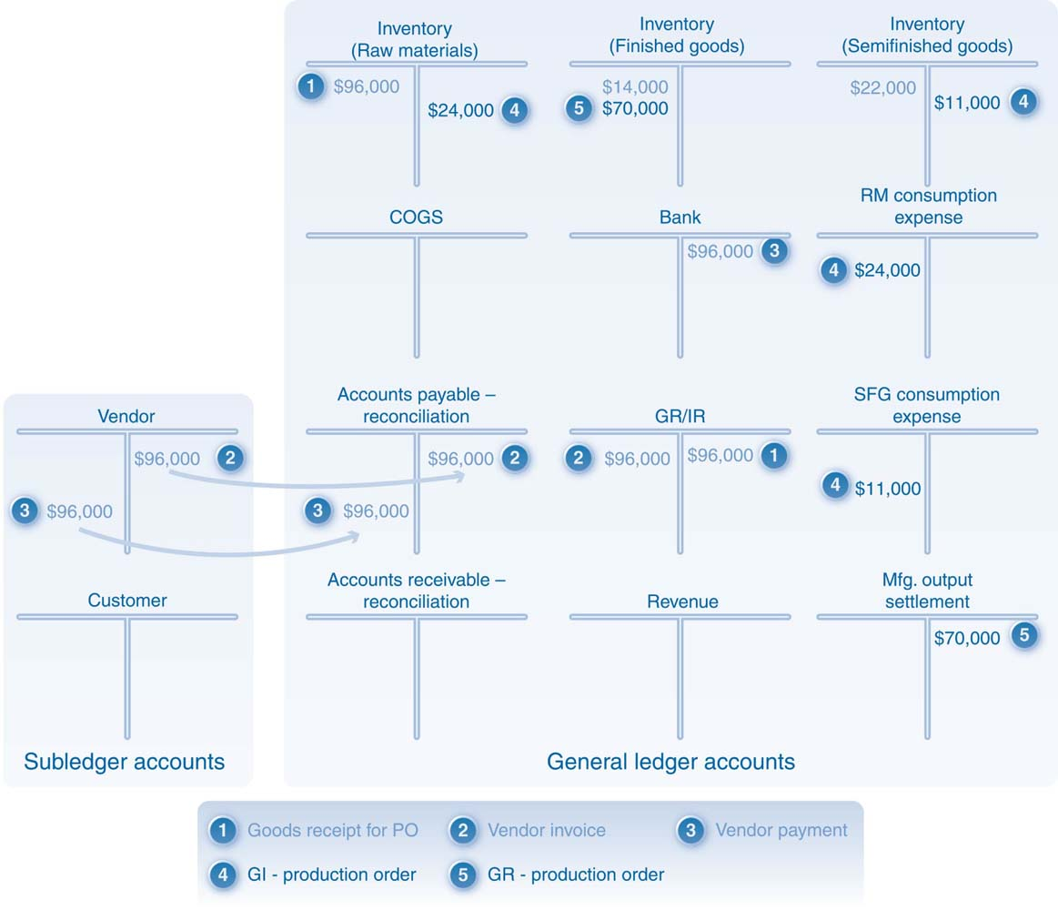
Account Balances after Production
Demo: Review Financials / SRL

Slide 19
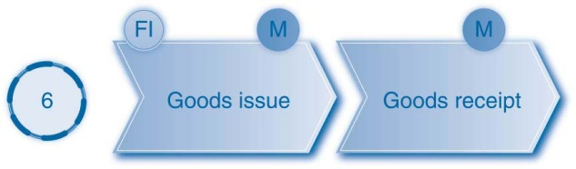
Inventory Management - Continued
Demo: GI / GR for STO

Slide 20
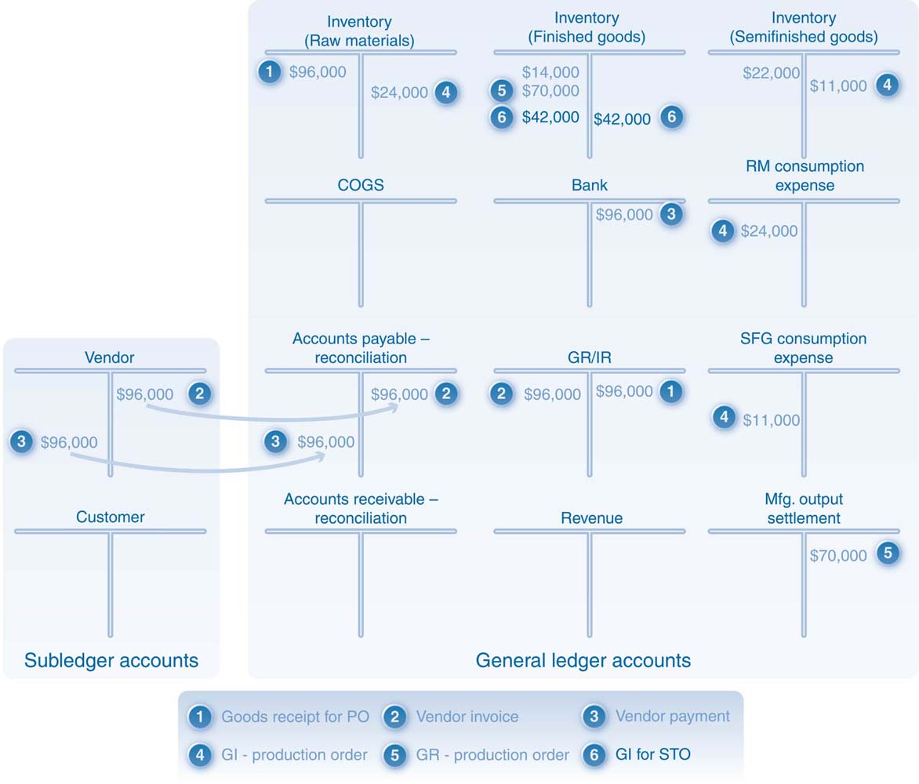
Account Balances after a Goods Issue against an STO
Demo: Review Financials / SRL

Slide 21
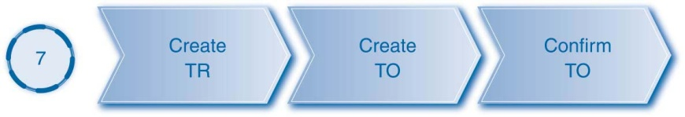
Warehouse Management Steps
Demo: WM steps in SD (inbound)

Slide 22
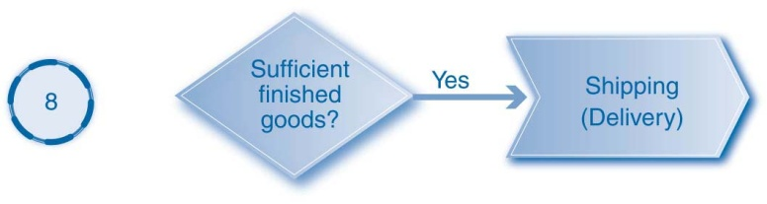
Fulfillment Process - Continued
Demo: Outbound delivery

Slide 23
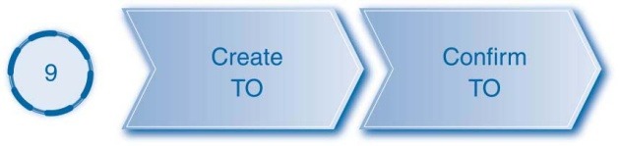
Warehouse Management Process
Demo: WM steps in SD (outbound)

Slide 24
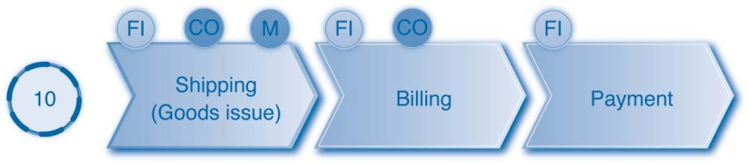
Fulfillment Process – Concluding Steps
Demo: Complete fulfillment

Slide 25
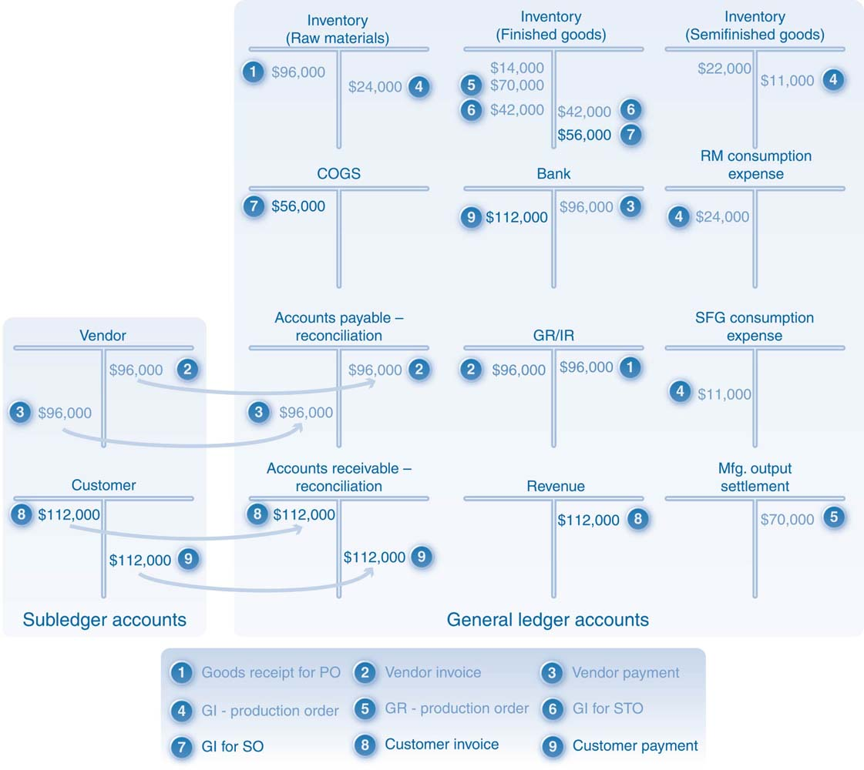
Account Balances after Fulfillment
Demo: Review Financials / SRL

